Slide 1



10 Plants That Changed Minnesota
Mary H. Meyer, Extension Horticulturist & Professor
Department of Horticultural Science, Minnesota Landscape Arboretum
Notes:
This slide set may take from 40-60 minutes, depending on your familiarity with the subject. See the handout and reference list for more information. You may have a ‘contest’ for answers throughout the presentation, or simply move to the next slide for the answers.

Slide 2
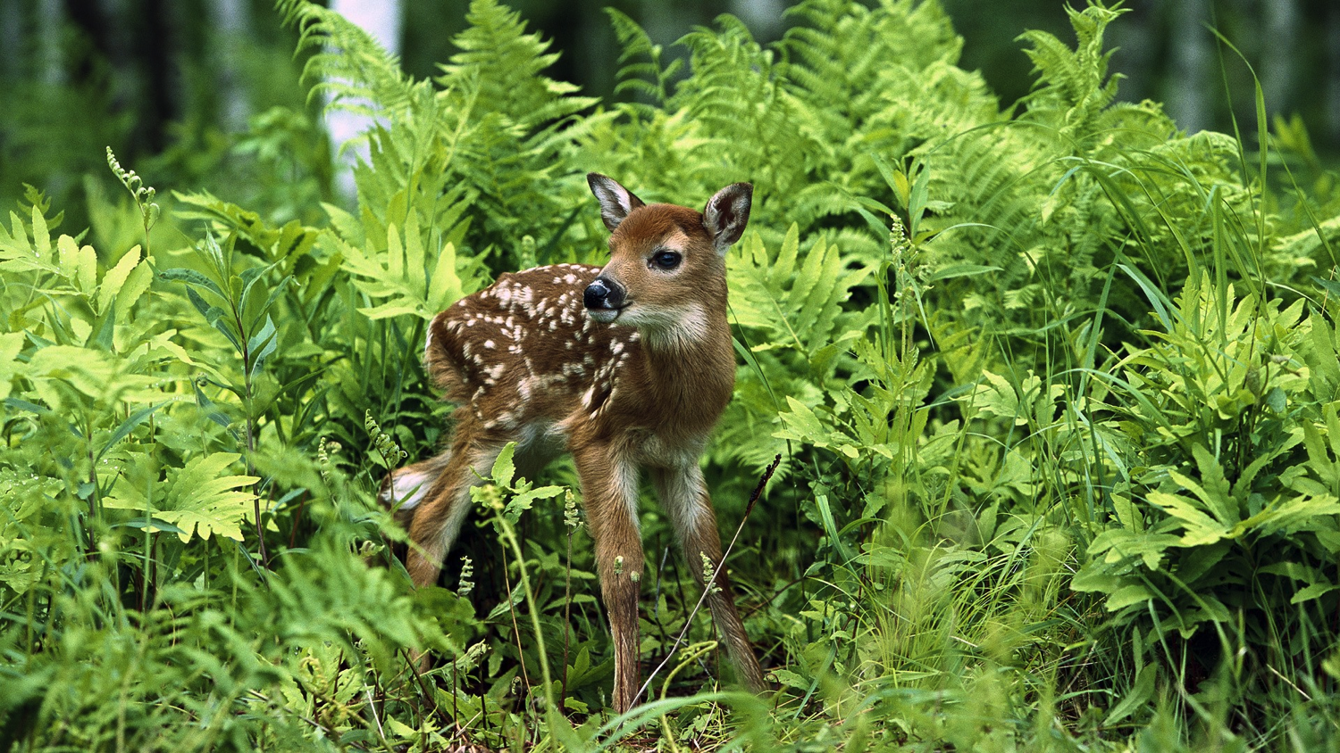

Slide 3
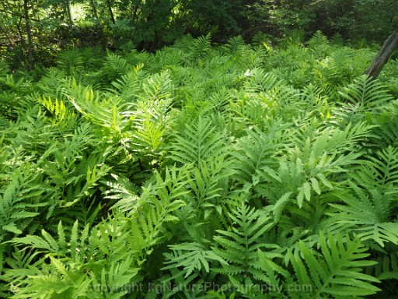

Slide 4

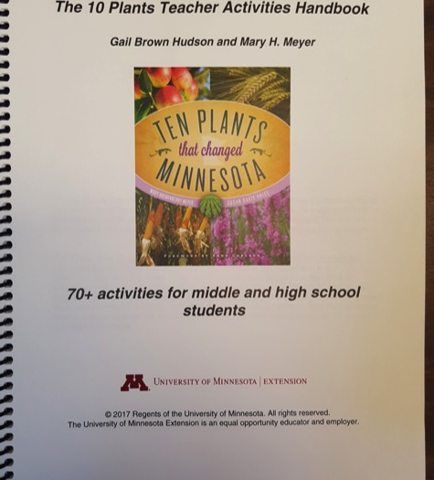
MN Historical Society
book and
teacher activities
handbook

Slide 5
10 Plants Educational Program
Spring 2012 Public Campaign for nominations, discussion
Andersen Horticultural Library Reading Lists
Freshman Seminar: HORT 1901: Fall 2012-2017
Ag in the Classroom 2012-13 Theme
Youth Challenge April-July 2013: 7 winners ages 8-17
Website development, Susan Davis Price: For public, Master Gardeners: http://top10plantsmn.org/
March 2017 MNHS publishes 10 Plants book
2017 Teacher Workshops with RSDP throughout Minnesota
Notes:
As of 2017, this is the status of the entire program,

Slide 6
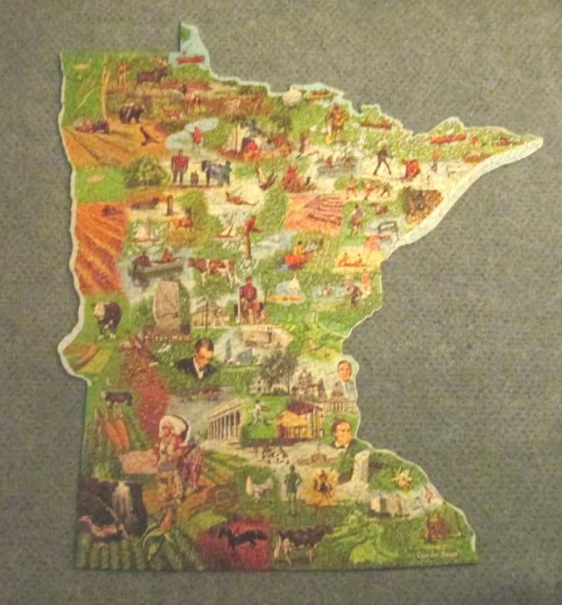
Now is your chance:
Name the 10 Plants!
Public Nominations Feb –April 2012
Over 500 submissions
Many plants, drawings, letters, and emails from teachers and students, general public
You have 1 minute!
Notes:
Ask participants to list the 10 Plants, allow 1 minute for them to list on a sheet of paper. You may award prizes here (candy, stickers, points for 1 grand total prize, etc.) or simply move to the next slide with the answers.

Slide 7
The final selections:
Apple (54)
Haralson (29)
Alfalfa (18)
Grimm (6)
American Elm
Corn (31)
Purple loosestrife (2)
Lawn/Turf (3)
Soybeans (14)
White pine (23)
Wheat (23)
Wild rice (35)
Notes:
Numbers in parenthesis indicate the public nominations for this plant. It is interesting to note that 5 plants are food crops and 5 are landscape plants. Alfalfa is a food or forage crop for dairy cows, so it feeds animals, and adds nitrogen to the soils where it is grown as a landscape plant.

Slide 8
Nominated but not selected:
Buckthorn (16)
Sugar beets (7)
Grapes (10)
Potatoes (6)
Dandelion (11)
Azaleas (6)
Ginseng (4)
Cutie orange
Eurasian milfoil (5)
Prairie turnip
Hops (2)
Rhubarb
Notes:
Some unknowns, some surprises (cutie orange!!), but these did not meet the criteria, see next slide

Slide 9
10 Plants Selection Committee
Alan Ek, Forest Resources department head
Al Withers, Ag in the Classroom, Director
Neil Anderson, Hort Science faculty
Bev Durgan, Dean of Extension
Bob Quist, Oliver Kelly Farm Manager, Minnesota State Historical Society
Brian Buhr, Ag Economics department head
Gary Gardner, Hort Science faculty
Karen Kaler, wife of President Kaler
Karl Foord, Extension Educator Horticulture
Mary Maguire Lerman, President of Minnesota State Horticultural Society
Nancy Jo Ehlke, Agronomy and Pl Breeding department head
Susan Bachman West, Bachman’s, Inc.
Mary Meyer, Hort Science faculty
Notes:
These folks considered the public nominations, and the criteria (next slide) and weighed all together. Selection was a balance of what plants changed and have influenced Minnesota the most based on the 6 criteria.

Slide 10
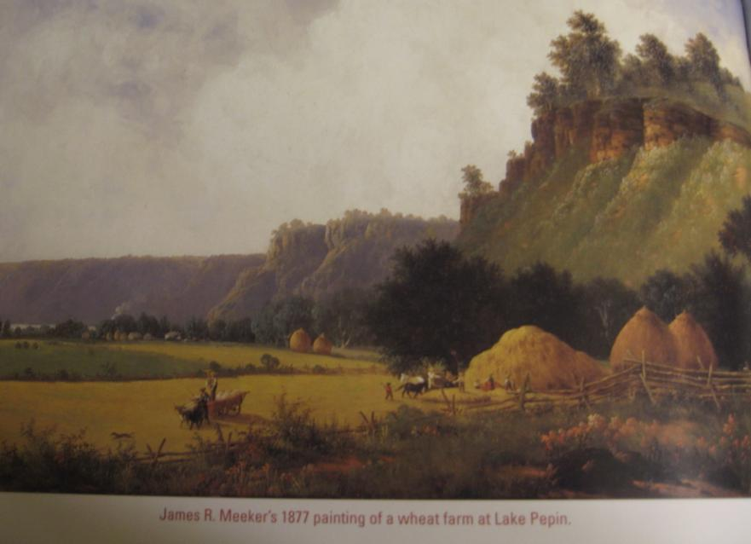
Criteria for Selecting the 10 Plants
Environmental
Economic or
industrial
Cultural/spiritual
Historical
Sustenance
Landscape
Notes:
These were the 6 criteria used to select the 10 Plants. Each was considered and balanced for how much the plants changed and affected Minnesota. Image is James R. Meeker’s 1877 painting of wheat harvest at Lake Pepin, Minnesota.

Slide 11
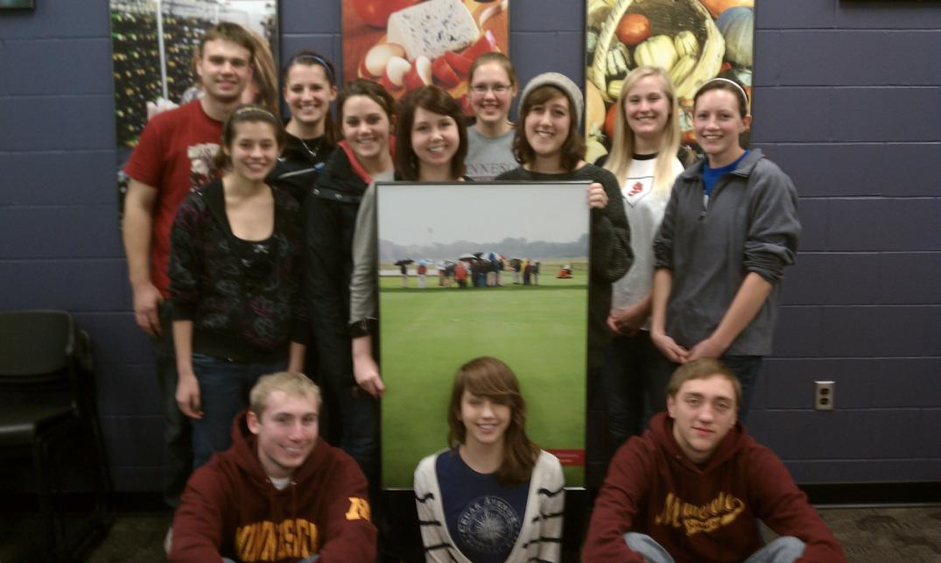
Hort 1901 Freshman Seminar
Notes:
Students in the first 10 Plants Freshman Seminar at the University of Minnesota, fall 2012. Each student contacted and introduced a 10 Plants expert, compiled website information about one of the 10 plants and developed youth activities about the 10 plants. The class met at the Minnesota Landscape Arboretum and the lectures were open to the public.

Slide 12
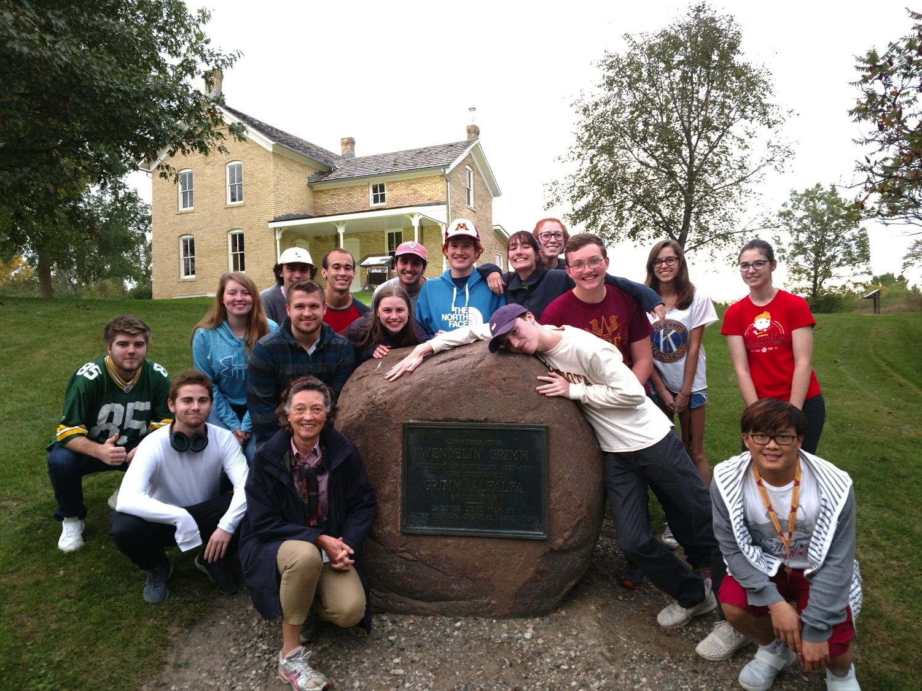

Slide 13
Minnesota’s 10 Plants
2 forest trees: white pine and American elm
3 annual row or field crops: corn, soybeans and wheat
1 perennial crop: alfalfa
2 food crops: apple and wild rice
2 landscape: lawn and purple loosestrife
Do you have a story or
memory of these plants ?
Notes:
This summary slide shows the upcoming sequence of the 10 plants. You may choose to cover all 10 or select a few to highlight. These plants have affected all of us, reflect on a memory or story, as you think of these plants.

Slide 14
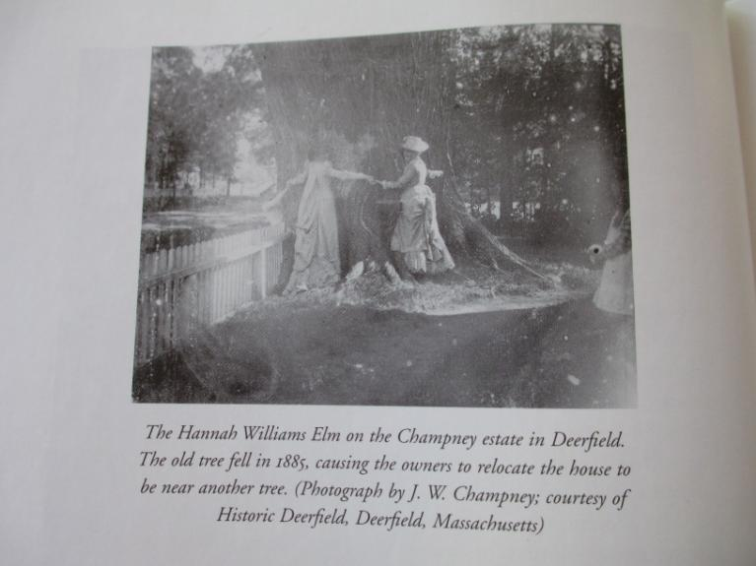
American Elm
America’s favorite shade tree
Wildlife value: Ulmus supports 215 species of Lepidoptera (Tallamy,2007)
Memorial Drive in Minneapolis an elm for soldiers and nurses who died in WWI 568 plaques/trees
photo from Campanella, T. 2003.
“ ….causing the owners to
relocate the house to be
near another elm.”
Notes:
Information about each of the 10 Plants, Image is from The Republic of Shade, an amazing book on the American Elm, see references. Can you imagine moving your home to be near a tree? Lepidoptera are only butterflies and moths, many other insects and animals use American elm for food and habitat.

Slide 15
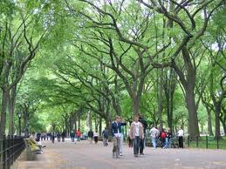
American Elms in Minnesota
1 in 100,000 American elm is DED-tolerant. Before DED, Minnesota had over 140 million elms
How many in Minneapolis in 1975? Today?
1975: 300,000+
Today: 50,000
Notes:
DED is Dutch elm disease, see handout for references if need be on history of this disease. Answers to two questions will come in on mouse click and can be used as ‘competition questions’ for participants. You can add local information about your town’s elms, care and management. Treatment helps to slow the disease, however some plants will still succumb.

Slide 16
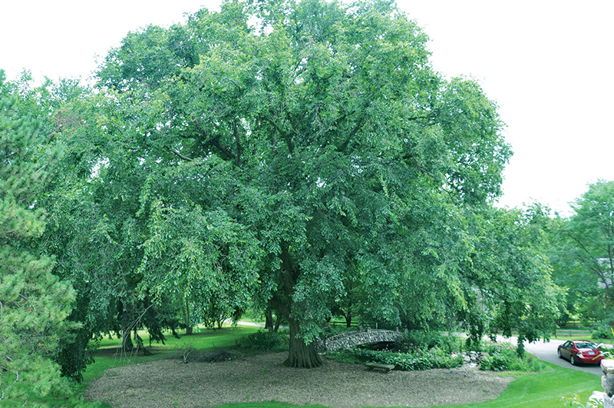
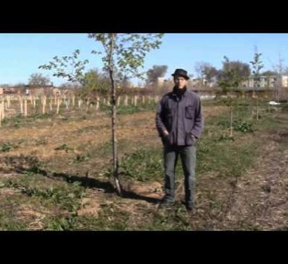
U of M TRE Nursery: Chad Giblen American Elm
St. Croix elm
Princeton, Valley Forge,
New Harmony
Notes:
Pictured is Chad Giblen, a research scientist at the U of M who works on disease resistant elm. Princeton, etc, are new varieties that are resistant to DED and can be planted without fear of DED. The new varieties are fast growing , drought tolerant trees for Minnesota. The main thing we learned and must remember from DED is monocultures are not good, plant a variety of trees in towns and on home landscapes. Diversity is good.

Slide 17
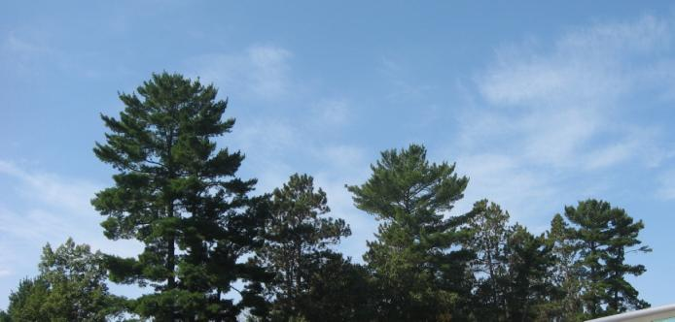
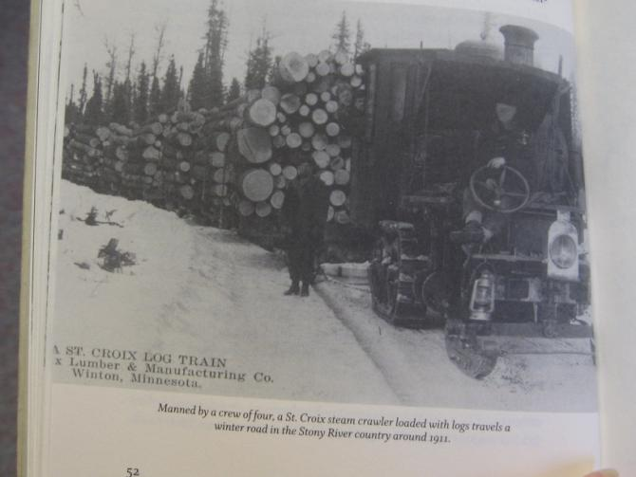
White Pine
Built the cities of the Midwest: Chicago, Minneapolis
Access with rivers and then rail made MN harvest easy
Desirable wood: cuts like cheese
Notes:
Millions of white pine have been harvested from Minnesota. The pagoda skyline, top photo shows the unique branching of white pine that is typical of the northern coniferous forest of Minnesota. The lower photo shows a huge load of white pine harvest.

Slide 18
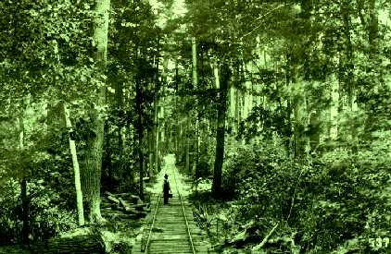
Notes:
An amazing photo of the rail line in a forest. White pine was likely never a monoculture in the forest, but one of many species. Note the logs laid for the rail line.

Slide 19
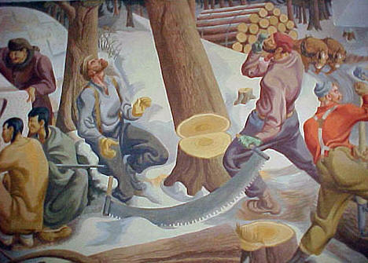
Portion of the 72 foot WPA mural painted in 1938 at Sebeka High School, Wadena County.
Notes:
Many immigrants found work harvesting white pine in Minnesota. Original photos show harvest with an ax, this saw would have been a later implement for harvest.

Slide 20
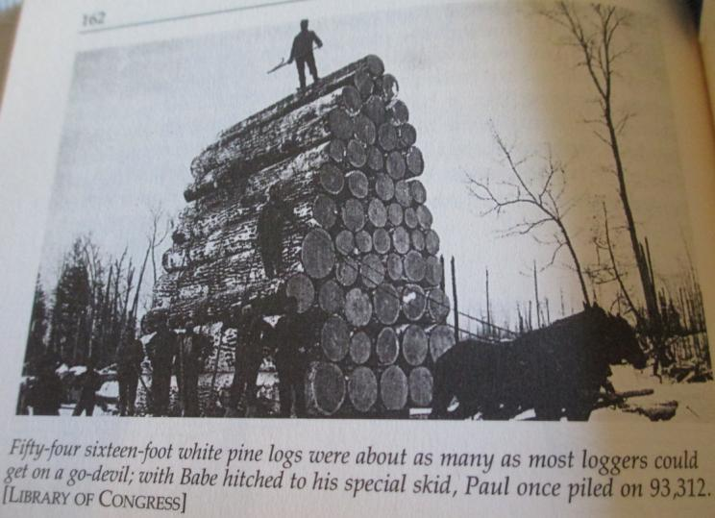
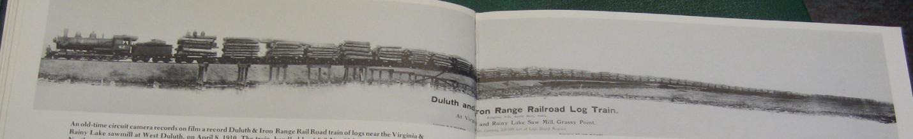
Notes:
Read captions if possible. While it was originally thought to last forever, the white pine harvest happened quite quickly as mechanization and the rail lines developed.

Slide 21
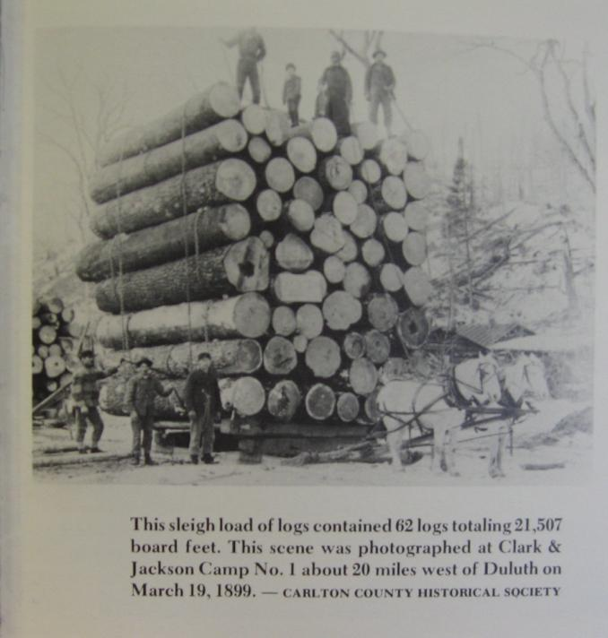

Slide 22
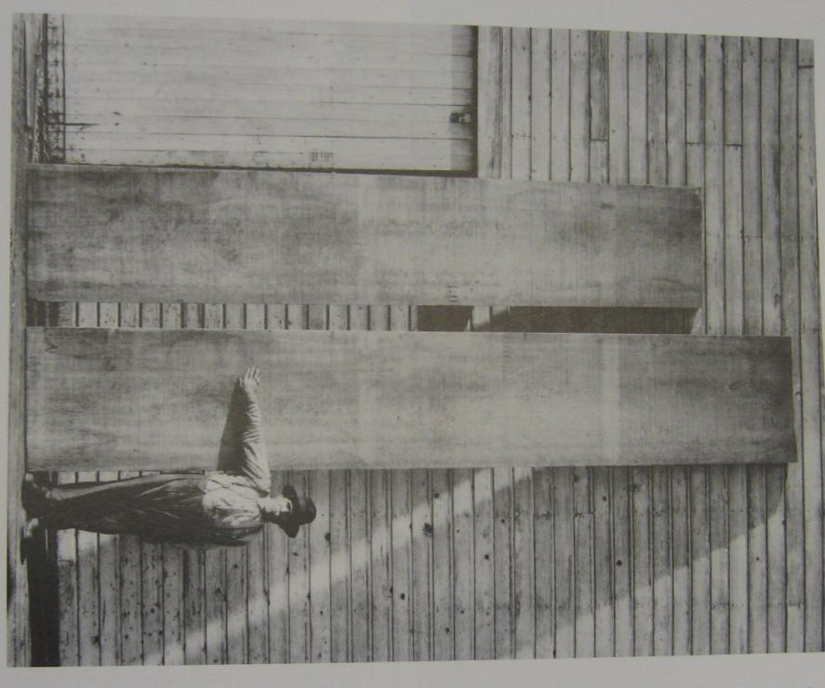
A common food item
uses white pine…
children and adults
love this, and most people walk while eating this food.
What is it?
Popsicle or
ice cream on a stick,
these food sticks are
made from white pine!
John Runk (1878-1967) photograph
Notes:
A man showing the size of a white pine board. Amazing!! And another quiz question.

Slide 23
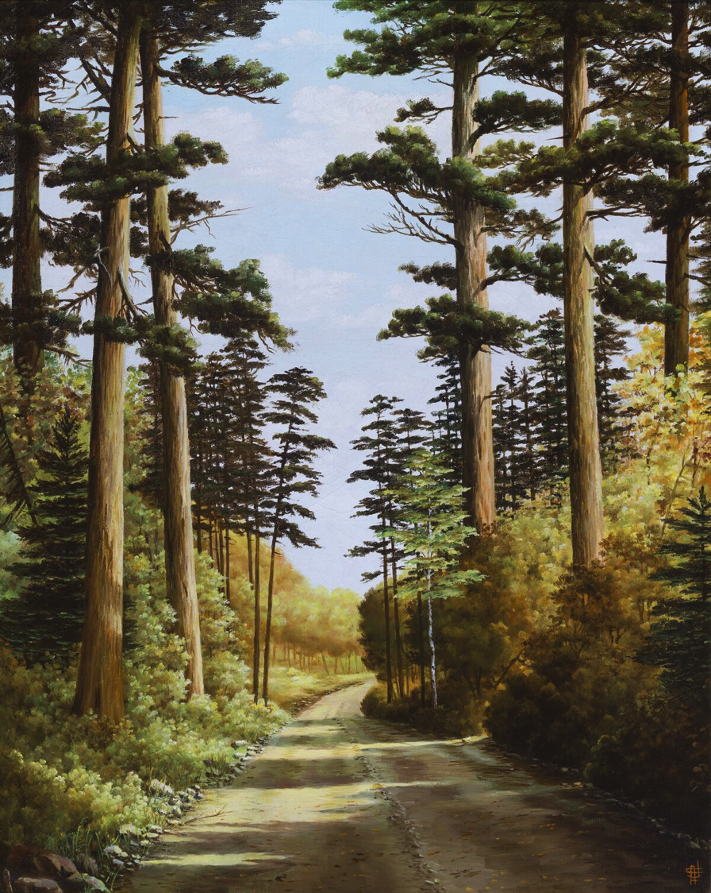
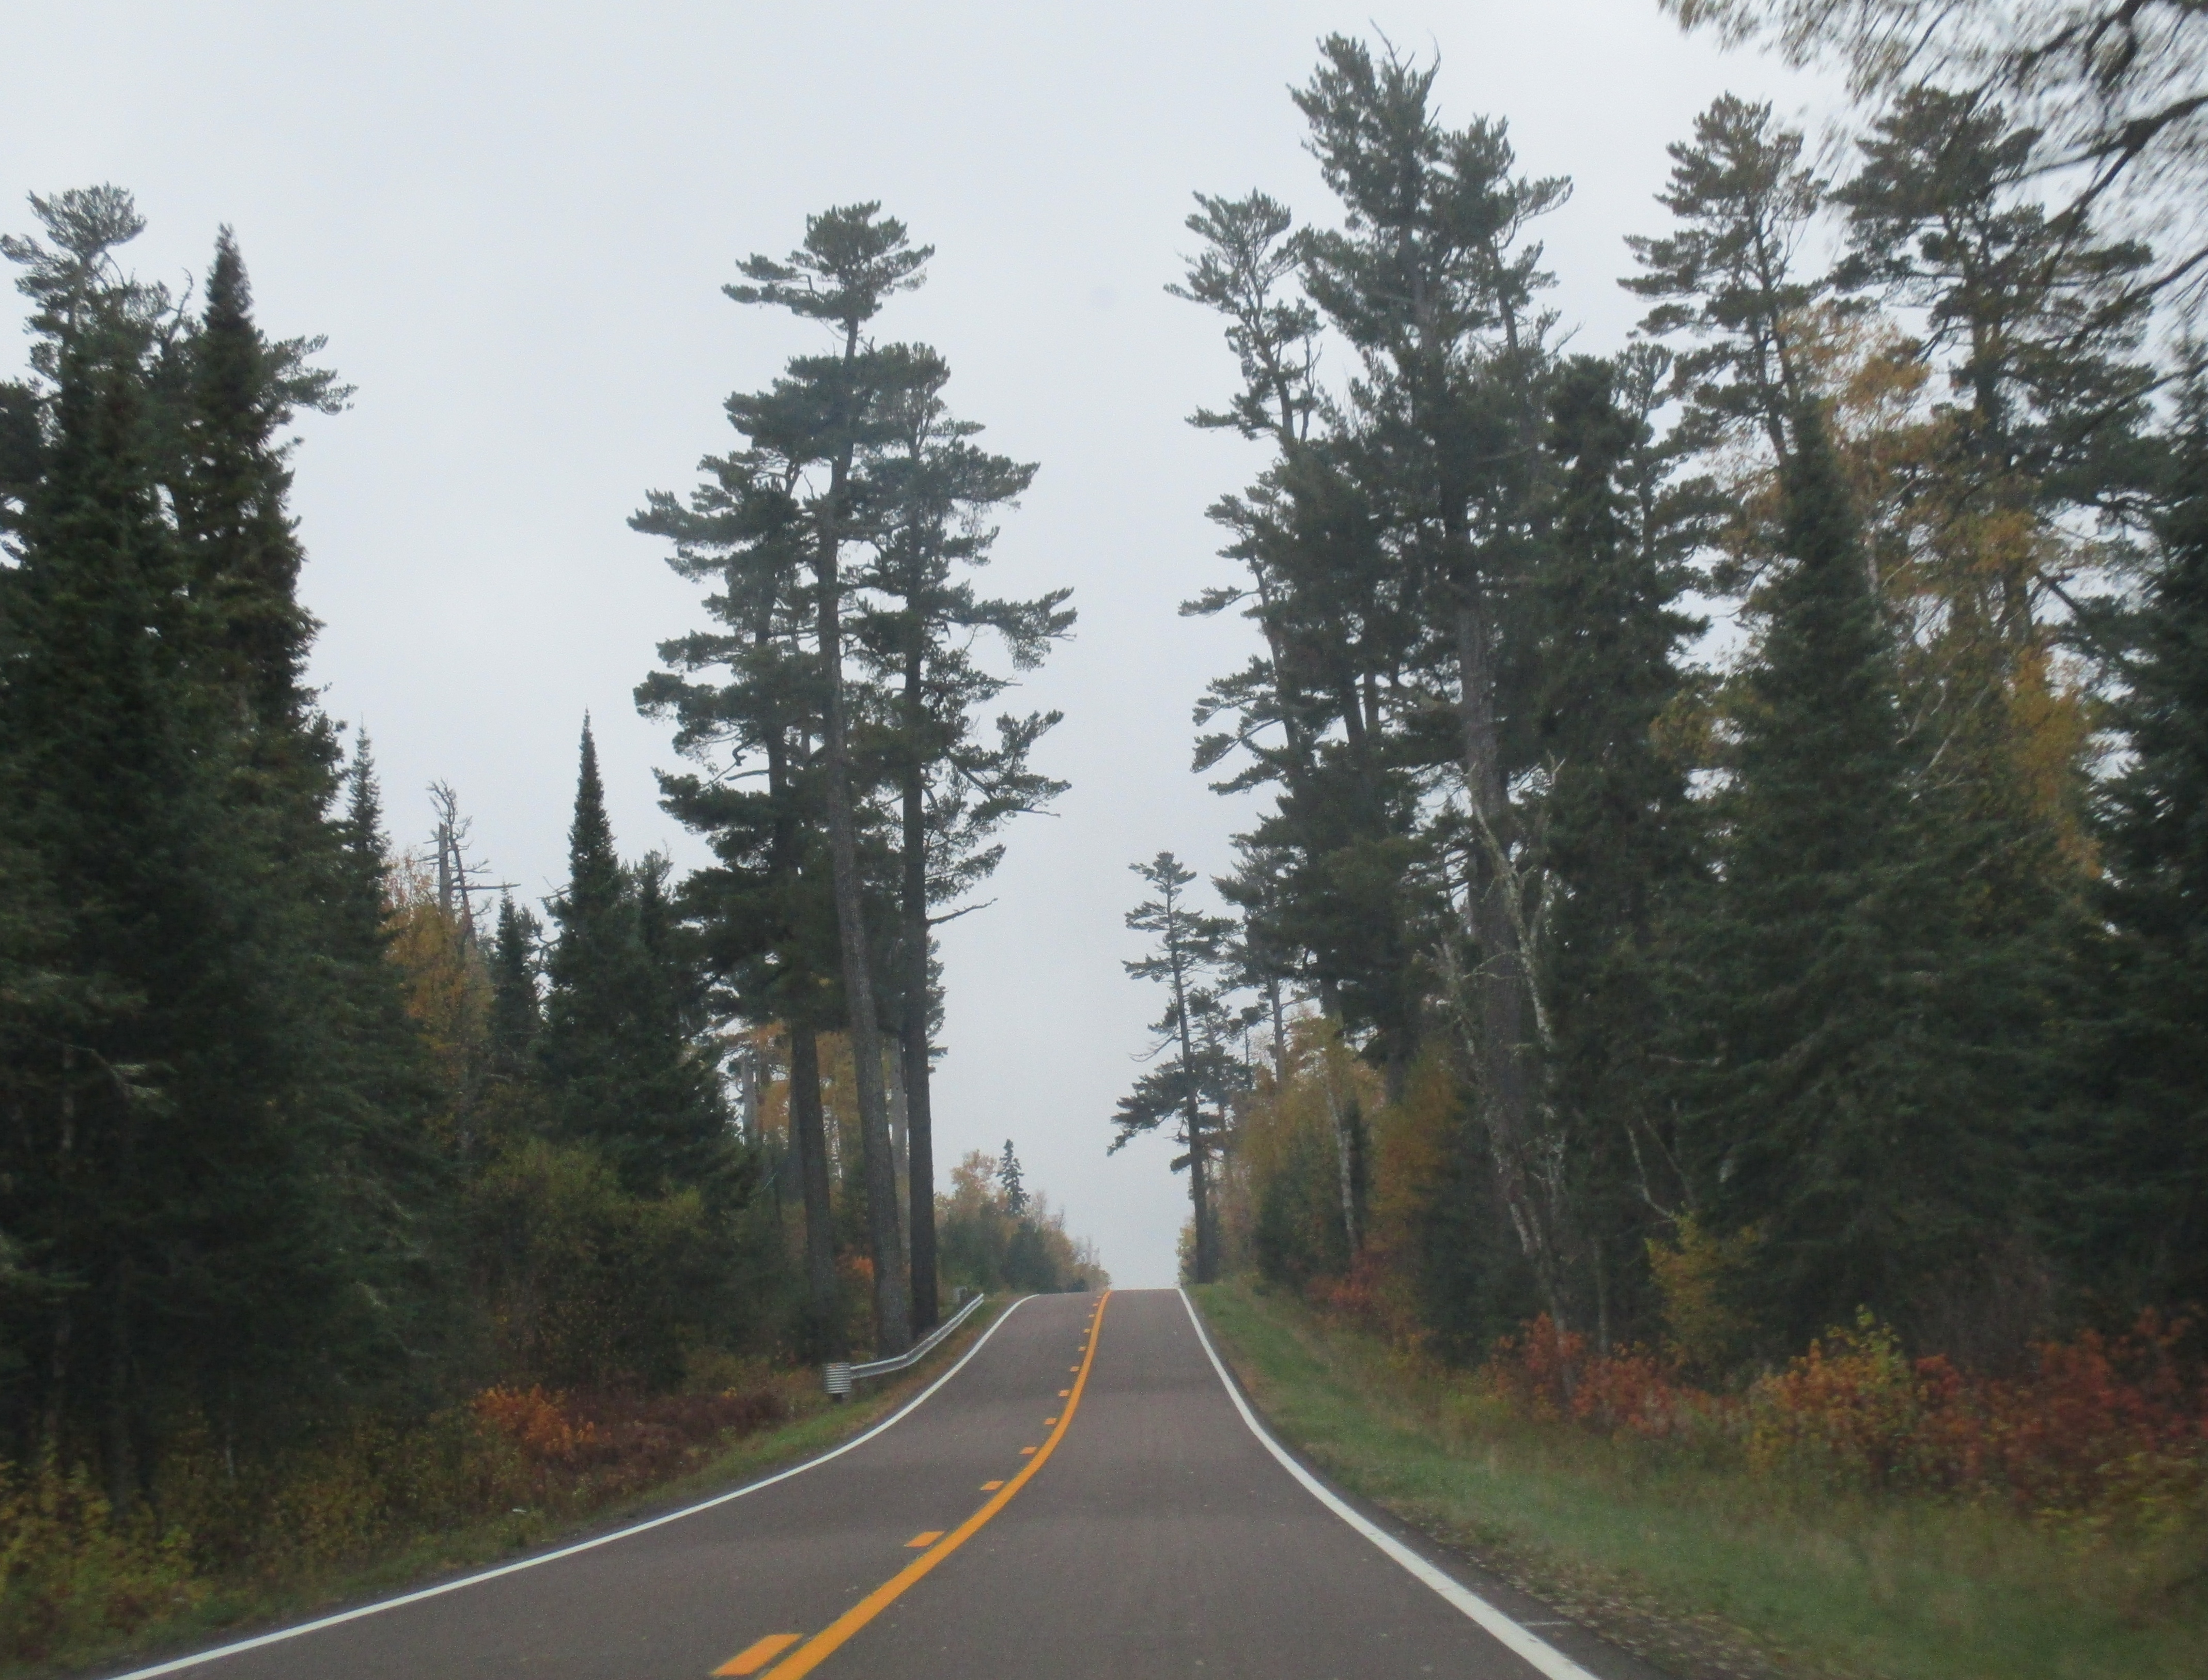
Anna C. Johnson (1881-1944)
painting
Gunflint Pines

Slide 24
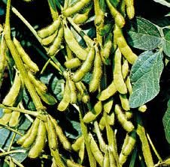
Soybeans
3. To China via rail through the Pacific Northwest
Where do Minnesota soybeans go:
1. US feedlots
2. many nonfood items
3. China
4. Europe and Russia
Notes:
Make your selection! On mouse click, the answer will appear. Yes, most of our high protein soybeans go to China. China purposely imports soybeans and as such helps our balance of trade. Most soybeans across the U. S. go to animal feed. Soybeans are also used in many non-food items.

Slide 25

How well do you know soybeans? Which of these statements are true?
Corn/soybean rotations have positive allelopathy: yield increases by 10%
Soybeans are a biomass wimp; plant residue is very small
Almost all crayons are made from soybeans
Minnesota produces 10% of the U.S. soybean crop
All of these statements are
True!
Notes:
On mouse click, participants will see all are true. Why do we care if crayons are made from soybeans? (children are likely to eat crayons)

Slide 26
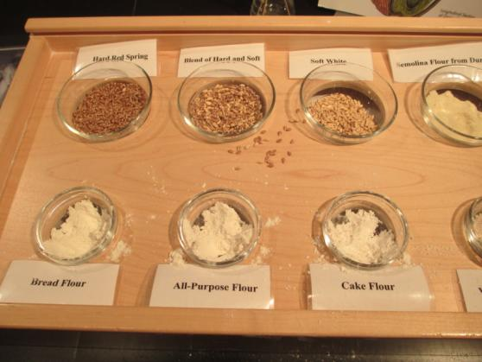
Wheat
The Washburn A mill produced how much flour per day in 1890? Enough for
12 million loaves of bread
5 million loaves of bread
1 million loaves of bread
Notes:
Wheat made Minneapolis and Minnesota famous. This is an amazing amount of flour coming out of one mill in 1890! Minnesota has cool weather favored by the wheat plant, and spring wheat grows well in Minnesota. Spring wheat, when crushed with ‘new’ metal rollers in the Minneapolis mills produced superior, fine flour that was favored throughout the world.

Slide 27
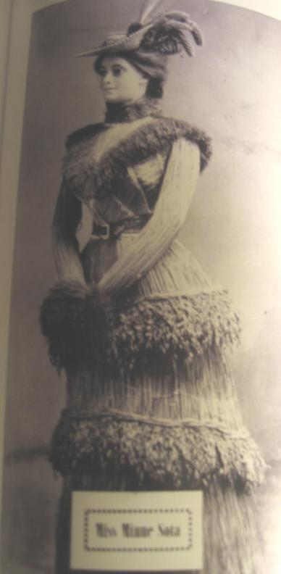
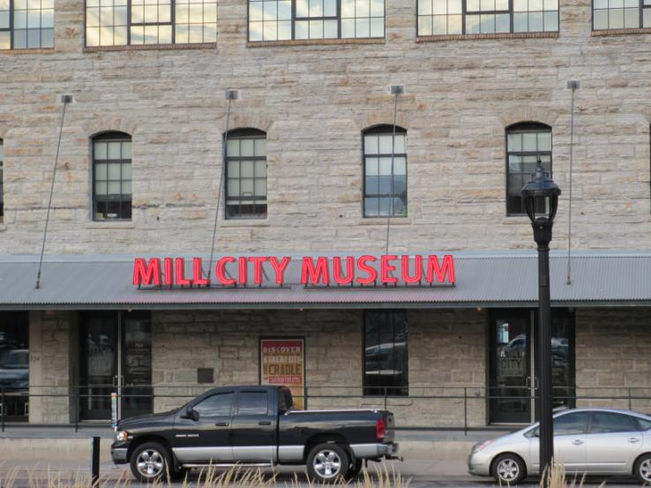
Minneapolis the Mill City
1880-1930: 50 years
Flour Capitol of the World
Notes:
Think about this: For 50 years, more flour was produced here than ANYWHERE in the world. How much our state has been built with wheat. Miss Minne Sota is a ‘woman’ made of wheat from a past state fair. The Miii City Museum is a great place for young and old to remember how Minneapolis depended on wheat, one plant.

Slide 28
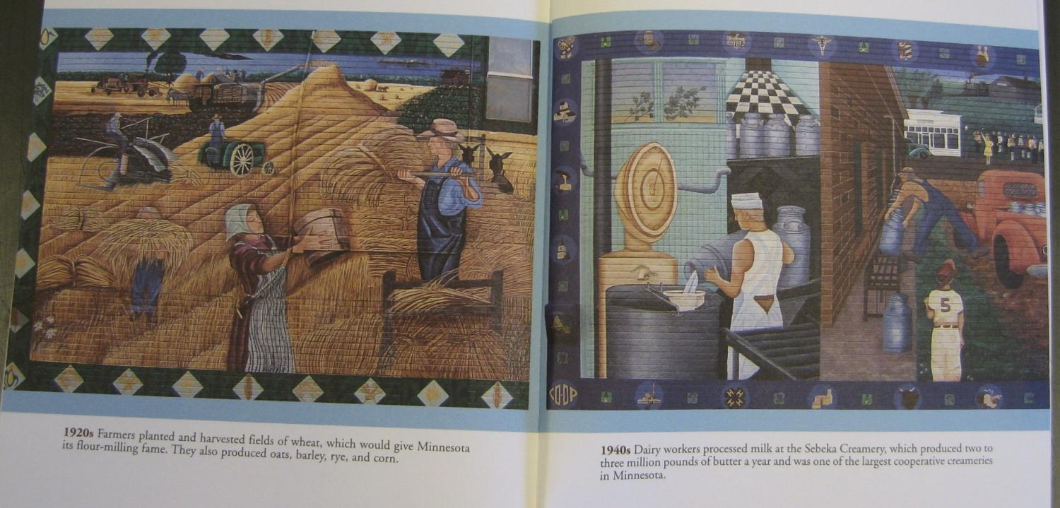
Sebeka WPA 1930’s Art Mural depicts several of the 10 Plants
Notes:
Sebeka (pronounced Sa-bee-ca)Minnesota has two murals depicting plants. The indoor school, 1930’s wonderful WPA mural depicts the historical scenes, a newer exterior mural, completed for the 1998 centennial shows more modern scenes. Sebeka is in Wadena County, west of Brainerd. If possible read the captions to participants, note the dates.

Slide 29
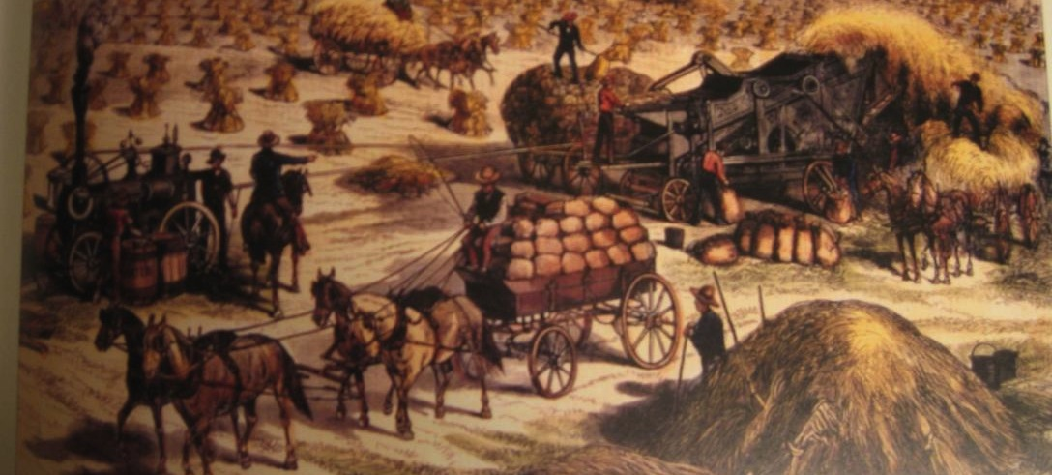
Bonanza Farms
Minnesota’s pure white spring wheat:
Cadillac of wheat
Notes:
Bonanza farms grew along the Red River in Minnesota and North Dakota as wheat became the first important row crop in Minnesota. “Oliver Dalrymple, in 1875, broke 1,280 acres of Red River Valley land, and in 1876 harvested 32,000 bushels of excellent wheat, averaging almost 23 bushels to the acre.” from King Wheat, see handout for complete reference. Wheat yield today is 50 bu/acre. Stem rust disease and lower prices made bonanza farms short-lived. Again, monocultures are problematic.

Slide 30
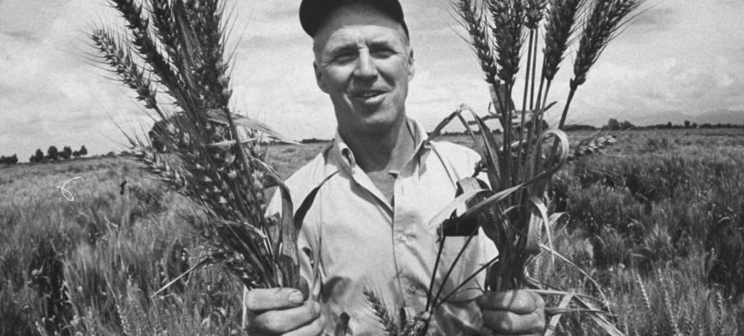
Norman Borlaug: dwarf wheat
Notes:
No mention of wheat in Minnesota is complete without discussing Norman Borlaug, 1970 Nobel Prize winner, often referred to as the Father of the Green Revolution. Borlaug, a plant breeder at the U of M, greatly increased wheat yield due to the introduction of a dwarf wheat plant, with larger grains and easier harvest. This scientific discovery has helped reduce hunger throughout the world. He is shown here on the cover of LIFE magazine.

Slide 31
Corn
Corn has undergone more human selection than any other crop
10,000 years ago corn was domesticated
Higher yields that other grain crops, easier to increase yields, why?
Notes:
Corn is an amazing plant with a very long history and close association with humans. Discuss why corn has changed in yield so much; Its genome is well researched, it responds to crossing or shows hybrid vigor more than other plants. Root and leaf architecture have been studied to enhance yield as well.

Slide 32
Wonder of maize or corn genome
“Maize individuals are much, much less alike at the level of the genome than people are, for one thing,” Ware says. The genome maps of two people will each match the reference human genome at around 98% of genome positions. Humans are virtually identical, in genome terms.
“But we’ve found that two maize individuals—from the W22 and Ki11 lines—each align with our new reference genome for B73 maize only 35%, on average. Their genome organization is incredibly different!”
Plasticity of corn……Doreen Ware, June 2017, Ohio State, Cold Springs Harbor Lab.

Slide 33
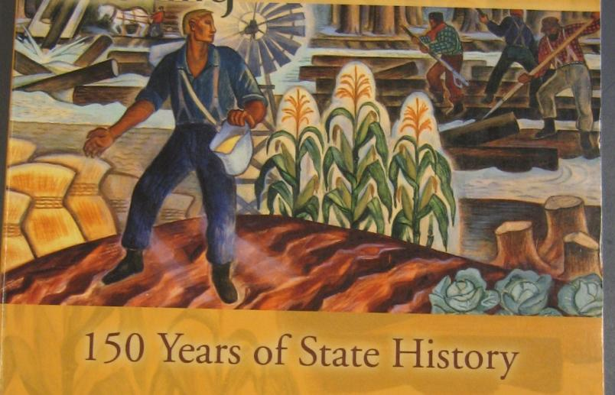
Corn
41% of MN cropland
MN supplies 9% of U.S. corn
2.2 million pollen grains per plant
How many kernels are on 1 ear of corn?
Each ear has about 800 silks/kernels
photo Keillor, S. 2007
How many ears does 1 corn plant
typically have ?
ONE
Notes:
Photo is again from Sebeka mural. Corn is a fun plant to grow and think about plant propagation. From 1 kernel comes 800 new kernels per ear, and a typical stalk has 1 ear per plant. Two questions will come in on mouse clicks.

Slide 34
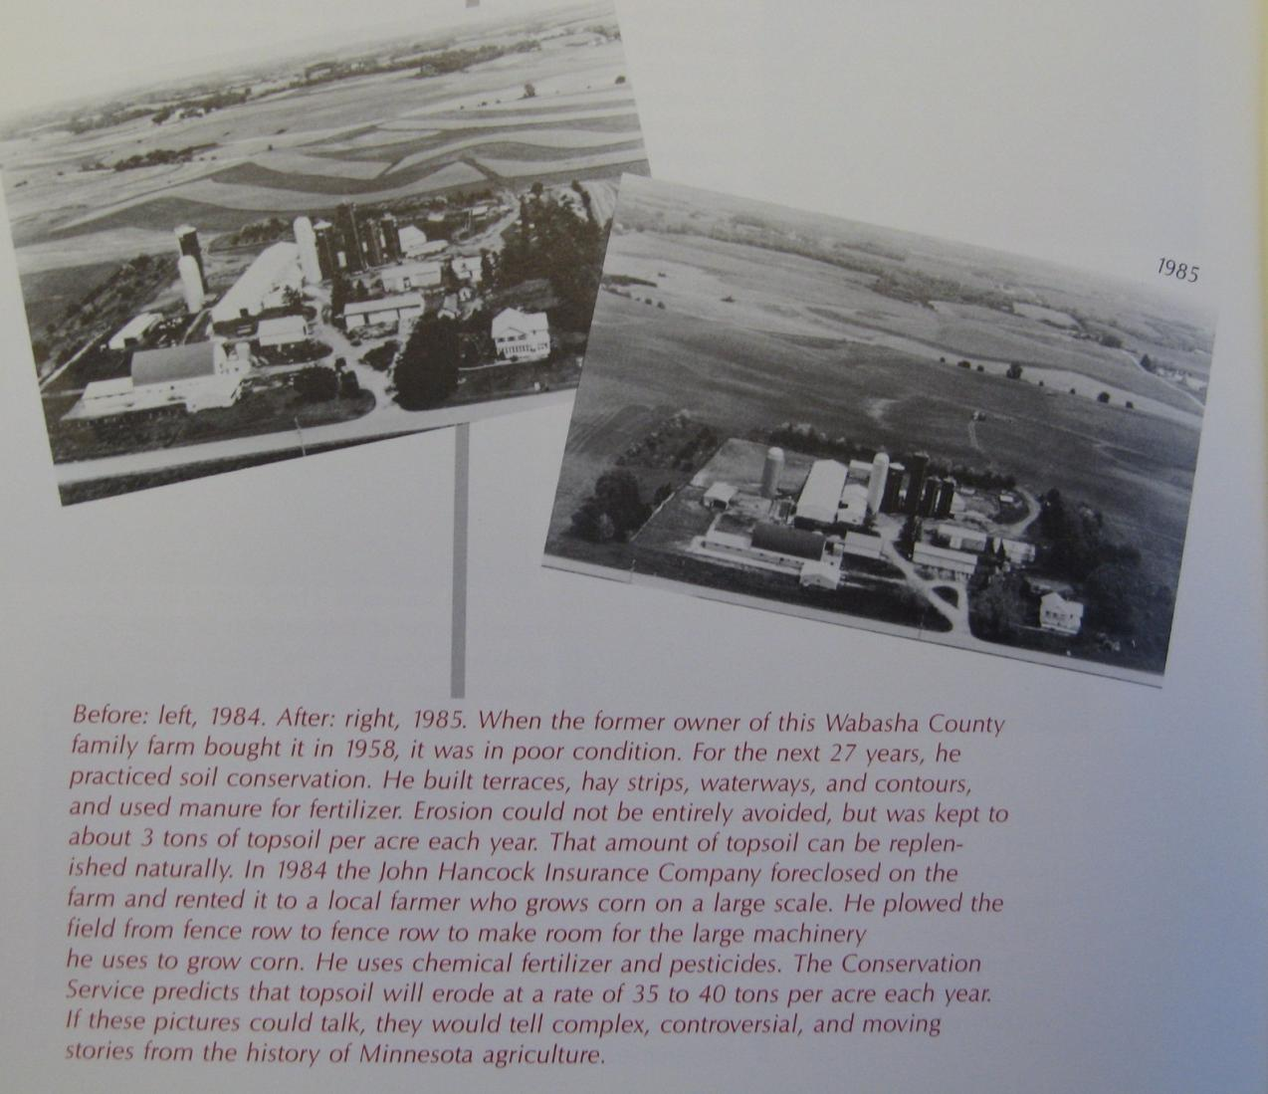
Contour planting, buffers
and diversity reduces
erosion by 10 times
Notes:
If possible read the caption. These pictures are just one year apart showing the changes with row cropping. Corn production has a big incentive: MONEY. That is why farmers plant it. It is a tradeoff for the land and soil conservation.

Slide 35
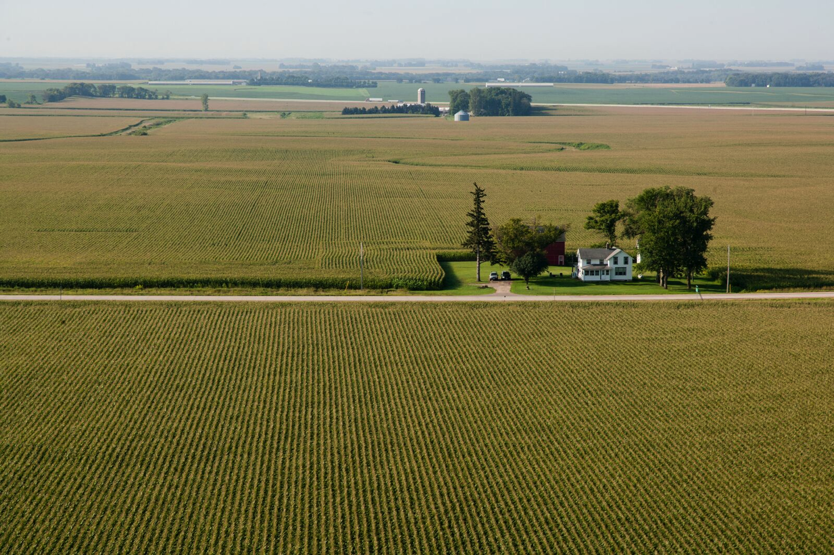

Slide 36
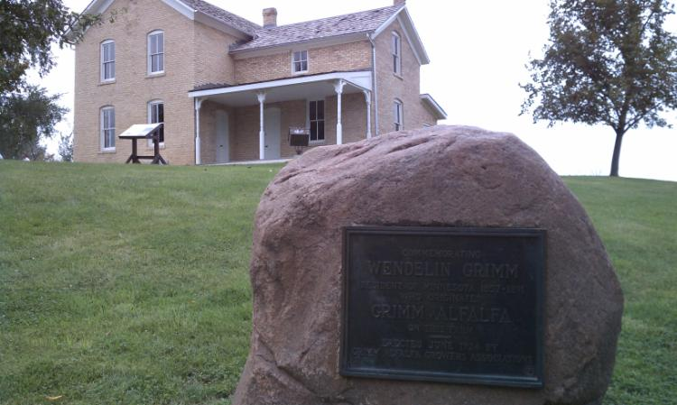
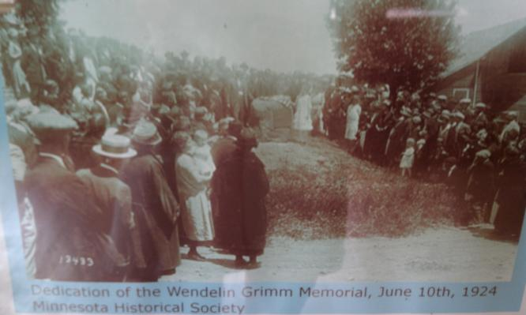
Alfalfa
Wendelin Grimm German farmer in Carver County, 1870’s selected plants and gave away seed
Perennial for dairy cattle
Important in soil conservation and crop rotations
Notes:
The top photo shows the Grimm Farmstead restored by Three Rivers Parks, you can visit this in Carver County Park, near Victoria. The plaque on the stone is shown in both photos. The lower photo is of the dedication of the farm when the plaque was placed on the rock, in 1924 commemorating Grimm and his work with alfalfa. MSHS picture, meyer photo.

Slide 37
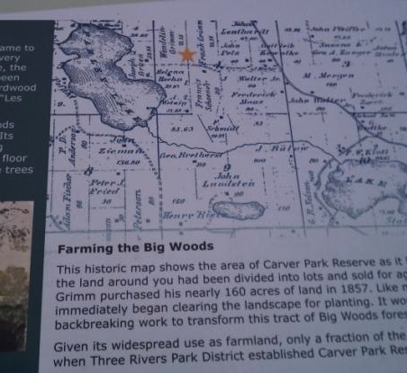
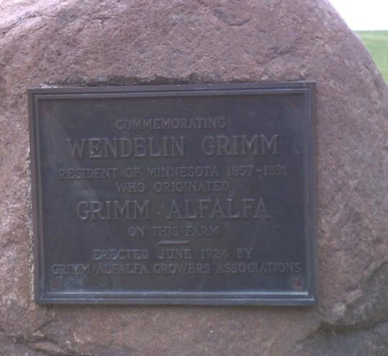
Upland Lester soil on Grimm farm
Notes:
Closeup of the plaque and a picture of the early settlement maps of the Grimm farm. The upland Lester soil ( Lester is the state soil), was important in the survival of Grimm’s alfalfa. Alfalfa will not grow in wet, poorly drained soil, so Grimm knew what he was doing when he managed his alfalfa on upland sites.

Slide 38
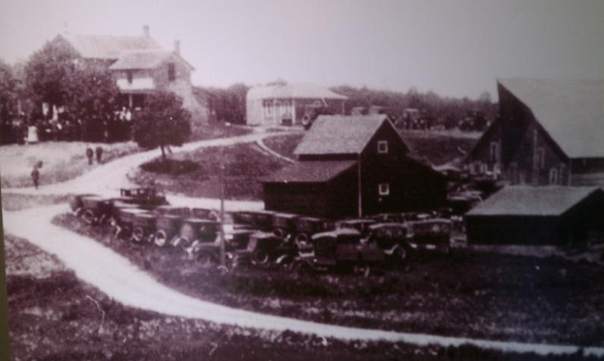
Grimm’s Alfalfa
It is estimated that Grimm's alfalfa is the basis for the United States' third largest crop (hay) accounting for 60 million acres (240,000 km²) and a value of $3.4 billion annually. (EPA, 2009)
Notes:
Only about 1 million acres are planted with alfalfa in Minnesota. Much smaller than the 7 million each for corn and soybeans. Although wonderful for building soil nitrogen naturally, and eliminating soil erosion as a perennial crop, alfalfa is not a big money maker for farmers.

Slide 39
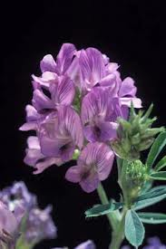
Alfalfa
Provides 100% of nitrogen (N) needed for corn 1st year after alfalfa
50% in second year
N credit is often mistrusted by farmers
Only 3 out of 31 fields tested needed additional N
Notes:
Alfalfa fixes nitrogen naturally as do all legumes. This nitrogen is released for other plants that grow in the soil after alfalfa. Farmers can determine how much nitrogen is available with soil tests. U of M research is the basis for the 4th statement on this slide.

Slide 40
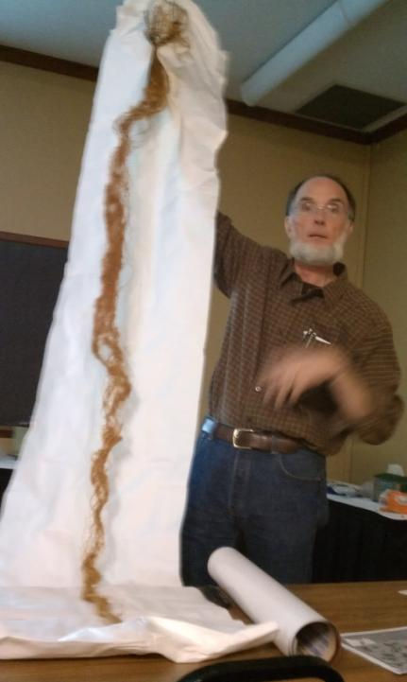
Alfalfa roots are several feet deep
68,900 miles of roots per acre with 53 pounds of N stored within the roots
Nitrogen fixation is important for sustainable farming
Row crops deplete soil N; alfalfa adds to soil N
Notes:
Michael Russell is a research scientists who works on alfalfa at the U of M. He is shown here holding one alfalfa plant. The very narrow part of the plant near the top shows the beginning of the roots! This plant is typical with 8-10 foot roots.

Slide 41

How many insect and spider species were found in a alfalfa field in a recent California study?
1,000
700
500
300
Notes:
Another question! Amazing number, alfalfa is loved by bees and many butterflies.

Slide 42
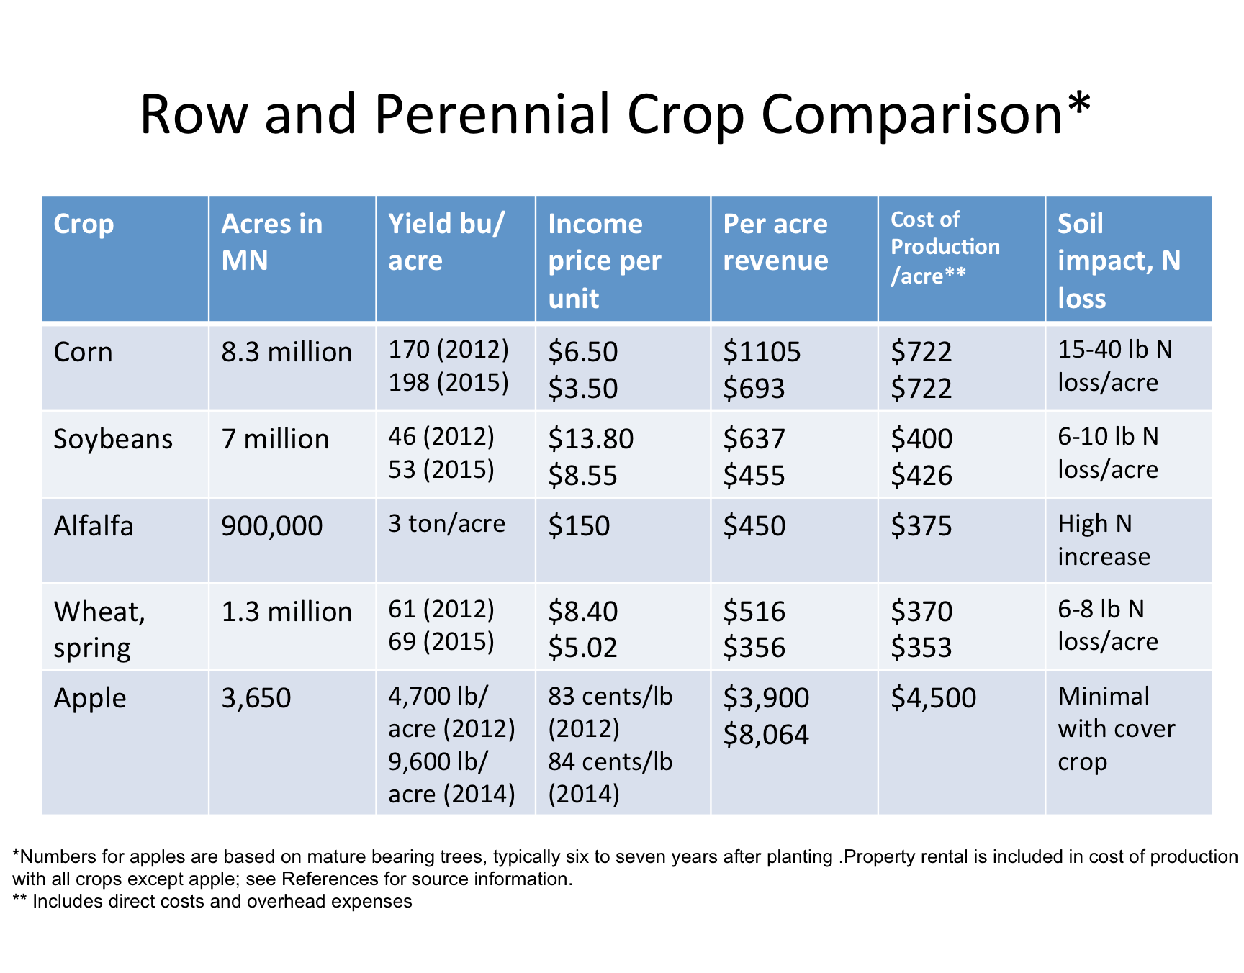

Slide 43
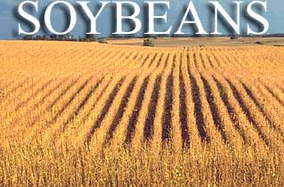
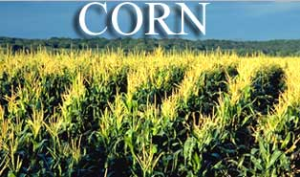
"Thirty percent of greenhouse gases entering the atmosphere today are from human agricultural activity. That's more than from all of our transportation, it's more than from all our electricity, and it's more than from all manufacturing. Agriculture has been the single most powerful force unleashed on this planet since the end of the ice age—no question. But agriculture is not an option. It's a necessity." –Jon Foley, Director, Institute on the Environment, U of M.
Notes:
Agriculture is essential, we all need to eat! And the U. S. exports much of its agricultural production. Management is the key. Reducing inputs that harm the environment, while increasing production to continue to meet human needs is a balance we must continually strive for.

Slide 44
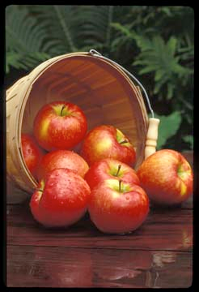
Apple
Prized by homesteaders : sweet and good storage
Horace Greeley: “I could not live in Minnesota, there are no apples”, 1860 NY Tribune
Entertainment?
Fermentation
Notes:
Apple was nominated by more of the public than any other plant, 54, in the 2012 nominations! 29 people nominated Honeycrisp! Horace Greely spoke publically about the harsh climate of Minnesota in this 1860 comment printed in a New York paper. (((After you ask what entertainment factor do apples have? )))) Ask if you think Mr. Greeley enjoyed apple cider so much that he could not live without it?

Slide 45
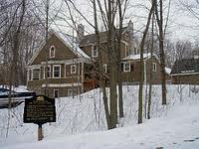
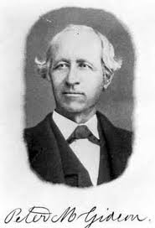
Peter Gideon
1868 selected ‘Wealthy’
Named after his wife
Hard to find today
MSHS lobbied legislature to purchase farm adjacent to Peter Gideon’s became the first Horticulture Research Center
Notes:
Another early farmer Peter Gideon, farmed near the Arboretum. The photo shows the historical plaque, house is not Gideon’s. He planted hundreds of apples and by chance found the Wealthy apple. This was a wonderful apple, and with this success, he continued to select and improve apples. Minnesota State Horticultural Society, was influential in starting the first Horticultural Research Center, has since moved to the Arboretum and is the Apple House and orchards along Rt 5 near Victoria.

Slide 46
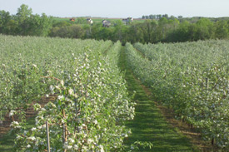
How many apples has the U of M introduced?
15
20
28
32
SweeTango;
Rave, First Kiss
Notes:
Yes, over many years 26 is the correct answer.

Slide 47
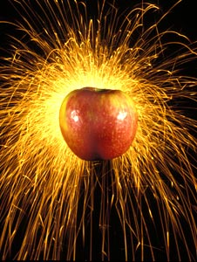
What rank is Honeycrisp in the U.S. ?
Number 1
Number 3
Number 5
Number 8
Introduced in 1991
Was 50 years old in 2012
Called Honeycrunch in Europe
Notes:
One question here. Then more facts come up. Although Honeycrisp was introduced in the trade in 1991, it was first selected 51 years ago. Yes, apple development takes a long time, due to it being a perennial tree!

Slide 48
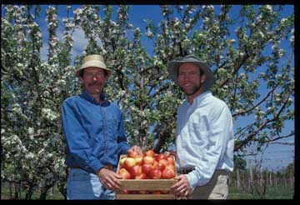
How many apples does Dave Bedford taste in a typical day?
125
240
380
450
500
Notes:
Pictured here is David Bedford, left and James Luby, right, both U of M researchers. Dave Bedford is the research scientist who does the field work of apple selection and breeding. When apples are ripe, he has a lot to taste! James Luby is the professor who does basis research and obtains grants to continue the breeding program.

Slide 49
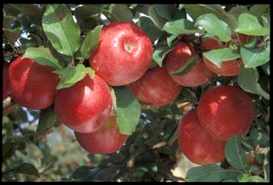
Apple
One taste and you are out!
10-15 selections per year; 2-3000 discarded per year
2,100 selections and only 28 released as new variety
Notes:
These numbers come from David Bedford. One taste of an apple and he must decide if it stays or is discarded! You can see how many are not worthy of keeping!

Slide 50
Apple
Charles Haralson 1st superintendent
Minnehaha and then Haralson 1922
How long was Haralson the #1 selling apple in Minnesota?
Until 1950
Until 1970
Until 1990
Until 2002
Notes:
Haralson apple is named for the first superintendent of the Horticultural Research Center. Most Minnesotans love Haralson apples.

Slide 51
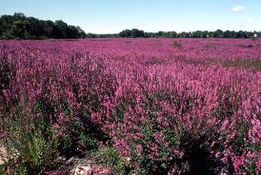
Purple Loosestrife
Poster child for invasive plants
Management with biological controls: beetles
Genetic changes
affect beetle preferences, and effectiveness in eliminating the plants
Notes:
Purple loosestrife is know to most people as an invasive plant. It was not always so well understood, and not long ago it was sold as an ornamental in nurseries. Today, as a noxious weed in Minnesota, it is not legal to sell purple loosestrife. Management with beetles that feed on the growing new shoots has slowed and decreased the acreage of purple loosestrife in Minnesota.

Slide 52
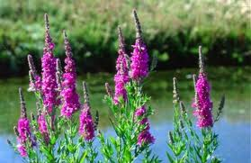
Learning from Purple Loosestrife
Changed our view of plants; we know we need to act faster, understand risks; seek multiple controls
Infestation has been reduced, not eliminated
Naughty but nice…what sweet food comes from purple loosestrife?
Bees love purple loosestrife..
honey made from this invasive plant
is delicious !

Slide 53

Wild Rice
Humans settled in Minnesota due to wild rice, native wild food that could be stored
Sustained European settlers, trade for Native Americans
Notes:
Wild rice was nominated by 35 people as one of the 10 Plants. Many people associate wild rice with Minnesota. It became our state grain in 1977. Minnesota today produces more than half of the world's hand-harvested wild rice and is second in the nation in the production of cultivated wild rice. Native to lakes and wet areas in much of the northern part of Minnesota, wild rice is an annual grass that stores well.

Slide 54

Cultural
Notes:
Many historic images can be found of wild rice harvest. There are several steps in wild rice harvest and preparation for storage. Harvest, shown at left, and winnowing, shown at right, removing the chaff from the grain are just two steps.

Slide 56



Wild Rice
Wild rice contains a phytochemical
oryzonal, cholesterol lowering effect
Low glycemic index, good for diabetics (AURI, 2013)
Notes:
The Minnesota Cultivated Wild Rice Council has information on nutrition and recipes for using wild rice. New research shows that wild rice contains cholesterol lowering compounds. Wild rice also has a low glycemic index. If you have not tried wild rice, you are missing a treat ! It is easy to cook and use in soups and many dishes.

Slide 57

Lawns or Turfgrass
$10 billion economic impact in MN
54,000 jobs related to turf
508,785 acres of green space
Notes:
Lawns are common in Minnesota, and cover many acres. Many people work in the lawn care industry or in recreational turf such as golf course management, or sports truf management.

Slide 58

Benefits of Turf and Lawns
Prevent erosion
Filter contaminants
Release oxygen
Moderate air temp
Reduce noise
Sequester carbon
Recreation space
Notes:
Listed here are the many benefits of turf or lawns. It is important to not over manage your lawn.

Slide 59

Best Management Practices for Home Lawns
Soil test every 3-4 years
Fertilize in early fall, if needed based on soil test
Never fertilize frozen soils
Mow high 3-4”; leave clippings
Water deeply and infrequently
Use a rain sensor on automatic irrigation
Use spot treatment for weeds
Consider ground covers for areas that are not used for recreation
Notes:
New recommendations are to have a soil test conducted on your lawn every 3-4 years; apply most of the fertilizer in early fall, as recommended by the soil test results, and to keep your clippings on the lawn. Leaving clippings on your lawn can save you money and reduce nitrogen runoff. Other recommendations are to water deeply and infrequently and to use a rain sensor if you have automatic irrigation. And mow your lawn high to 3 inches.

Slide 60

How much nitrogen is annually added per 1,000 sq ft from lawn clippings?
.5 lb
1 lb
2 lbs
3 lbs
Notes:
Leaving your lawn clippings is not only a good idea, its good for the environment and your lawn. For every 1,000 square feet a typical lawn will add 1 lb of nitrogen from the clippings in a growing season. Do not bag your lawn clippings!

Slide 61

http://top10plantsmn.org/

Slide 62


10 Plants Teacher Workshops
Teacher’s Activity Handbook
Middle and High School Students, can be adapted for any age
Informational website: top10plantsmn.org/
For more info: Mary Meyer, professor and extension horticulturist, meyer023@umn.edu; 612-301-1247

Slide 63
Row and Perennial Crop Production Revenue and Expenses References:
Lazarus, W. 2015. Cropbud Revenue for Row Crop Revenue. University of Minnesota Extension. accessed 15 February 2016. <http://faculty.apec.umn.edu/wlazarus/documents/Cropbud.xls. >
National Ag. Statistics Service. 2015. Statistics by State Minnesota. accessed 27 April 2016. https://www.nass.usda.gov/Statistics_by_State/Minnesota/Publications/Annual_Statistical_Bulletin/2015/MN%20Bulletin%202015_Page11.pdf>.
University of Minnesota. 2016. Finbin. Center for Farm Financial Management. Accessed online 6 June 2016. https://finbin.umn.edu.
University of Minnesota Extension. 2016. Before You Start An Apple Orchard. Accessed 27 April 2016. < https://fruit.cfans.umn.edu/apples/beforeyoustart/>.

Slide 64



References and Acknowledgements
AURI, http://www.auri.org/2013/01/unlocking-wild-rices-health-benefits/"Major Crops Grown in the United States“ wild rice nutritional information.
Campanella, T. 2003. Republic of Shade: New England and the American Elm. Yale University Press, New Haven, CT. http://yalepress.yale.edu/reviews.asp?isbn=9780300097399&printer=y
Keillor, S. 2007. Shaping Minnesota’s Identity: 150 Years of State History. Pogo Press.
Larson, A.M. 2007. The White Pine Industry in Minnesota: A History. University of Minnesota Press.
Tallamy, D. 2007 Bringing Nature Home. Timber Press. Portland, OR.
US Environmental Protection Agency. 2009-09-10. Retrieved 2010-11-06.
Special thanks to:

Slide 65

Notes:
I hope the 10 Plants has helped you to appreciate the importance of plants in Minnesota and that you will see plants with new eyes. Growing plants is an exciting and rewarding career that is behind the Seed Your Future initiative, to promote careers in horticulture and plant science. I encourage you to share your stories of plants and how they affect you with the younger generations.

